Slide 1

The Experience Hub
Client Experience
Associate Experience
Technology, Scalability & Efficiency
Quality
Predictability – Data Driven Insights
In an increasingly complex, connected world the contact center is set to become the interaction hub of the digital enterprise – responsible for support, problem solving, co-creators of unique experiences, educators and brand-enhancing ambassadors.

Slide 2
Building the Blueprint – Short Term Plan
Understand
Assess
Optimize
30 days
60 days
90 days
Craft the Plan & Programs
Client Pain-Points/Engagement Assessment
Client profiles/Person’s
CX Team Resource Needs
Start the Customer Journey Map
Data Collection, Measurement, Analyzation
Tools and Techniques
Refine, Rinse and Repeat
Map the Landscape & Roadblocks
CX Maturity Model Assessment
Quality Review
SWOT & Gap Analysis
Roadmaps/Goals
KPI’s
Change Management Strategy
Employee Engagement Program
Gain Visibility
Customers
Team
Peers
Products
Technology
Measures of Success

Slide 3
Plan on a page (Sample) – Medium Term Planning
Vision
Transform the organization to provide a world class customer experience that has the right strategy, infrastructure, processes & go to market approach that supports the overall company vision and drives revenue, retention, and rock-solid relationship opportunities.
Create and nurture a client delivery model or experience hub and define successful outcomes
Manage with a disciplined customer experience methodology across the globe
Strategy & Objectives
Build and refine customer journey map and establish a baseline for efficiencies and improvements
Ensure a culture of engaged & talented relationship experts and leaders - EX
Create & deploy roadmap & timeline for CX VOC strategy
Administer and report on quarterly NPS pulse
Support business on inner loop governance process
Create VOC strategy for strategic corporate initiatives
Initiatives
Review and refine employee engagement program
Update work on segmentation & data modeling
Organizational structure roles and responsibilities review
Client surprise and delight program
Measures of Success
Client Retention
Client Satisfaction
NPS
Internal Engagement (EX)

Slide 4
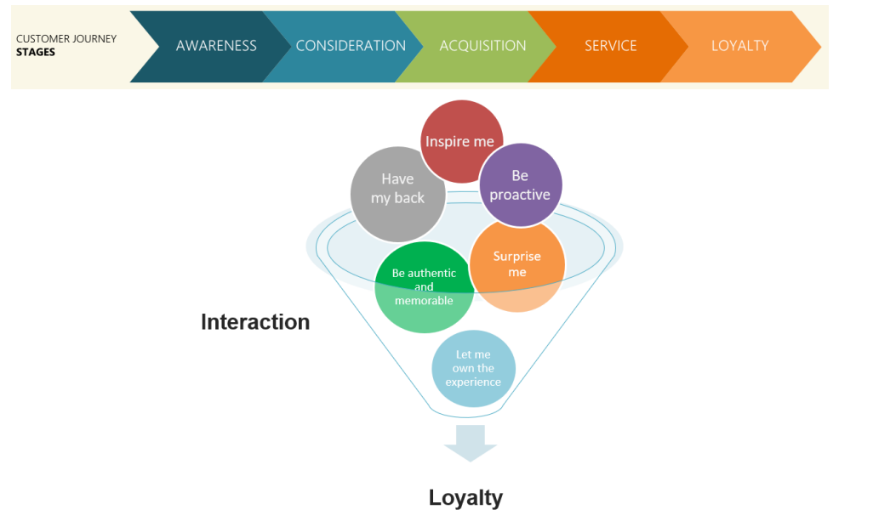
Client Experience
"I've learned that people will forget what you said, will forget what you did, but people will never forget how you made them feel..." Maya Angelou

Slide 5
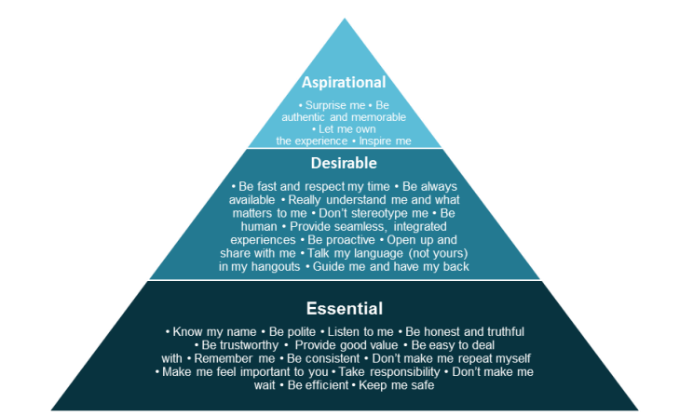
Client Experience
The fundamentals and emerging expectations of customer service – Building customer intelligence factors through AI technology implementation:
Deeply understand customers’
Target outcomes
Motivations
Emotion evokes
Actions
Personas
Followed by defining their
Company strategy
Workflow/policies
Culture to customer interaction expectations.
Incorporate Lean principles
What is the customer willing to pay for in your process. All other items are waste
Continuous process improvement
The experience hub focuses on how to get to here with each client interaction.

Slide 6
Customer Success Competencies
Vision: Transform the Digital Sales organization to provide a world class customer success ethos that has the right strategy, infrastructure, processes & go to market approach that supports the overall company vision and drives revenue, retention, and rock-solid customer relationship opportunities.
Customer Value/Goal Achievement
Understand customer goals and how to help them achieve this trough our products/services
Help customers remove roadblocks along the client journey
Customer Delight
Building a long-term positive experience around products/services and brand
Exceed expectations and gain loyalty
Create referenceable customers
Adoption & Usage
Maximize value & usage of products/services
Goal-based engagements – goals & milestones
Digital automation engagement strategy
Proactively provide value and use cases
Cross-sell & Up-sell Opportunities
Identify opportunities to sell further products/services through – Persona’s, data driven analytics etc.
Risk Identification
Visibility into customers’ behaviors that spotlights risks
Proactively be mindful of key factors that cause risk. DS market faces challenge of; time, resource and funding

Slide 7






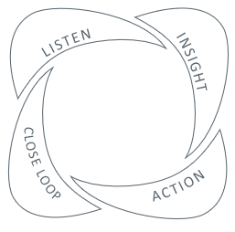
Client Experience Programs Overview
Net Promotor Score (NPS) Pulse Surveys
Providing quarterly corporate metric, comment analysis & theme identification
CX Governance/Action Planning
Leading meetings to review client feedback and satisfaction metrics, address pain points, and craft plans to mitigate reoccurrence
Voice of Customer (VoC) Journey Research
Developing and executing market research across the client journey & supporting the full spectrum, from client- specific requests to business unit transactional surveys
Client: (e.g., contractual obligations and end-user satisfaction studies)
Services: (e.g., support services/ call center and implementation key touchpoints)
Product: (e.g., pre and post feature analysis)
Closing the Loop
Ensuring both the business units and the overarching organization are communicating problem resolution efforts back to clients
Enterprise Feedback Management platform
Tool used to standardize and centralize activities associated with client experience measurement
CX Analytics
Providing first-class analytics, data science and insights to help the business make better, faster and relevant CX data-driven decisions
Unified 4 pillar program for success

Slide 8
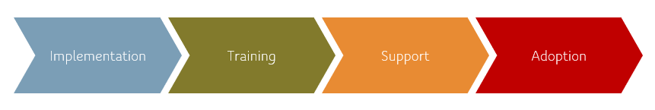
CLIENT JOURNEY – Creating “Micro-Journey’s” on Touchpoints – Mid to Long Term Plan
VOC starts with tying feedback and operational information back to the journey for maximum impact
The Traditional Client Journey:
AWARENESS
CONSIDERATION
PURCHASE
RETENTION
ADVOCACY
Service & Delivery
Micro- Journey Event
FORM
GROW
FOSTER
SOLIDIFY
It’s really about building relationships by knowing what drives an exceptional
client experience and quickly addressing pain points along their journey

Slide 9
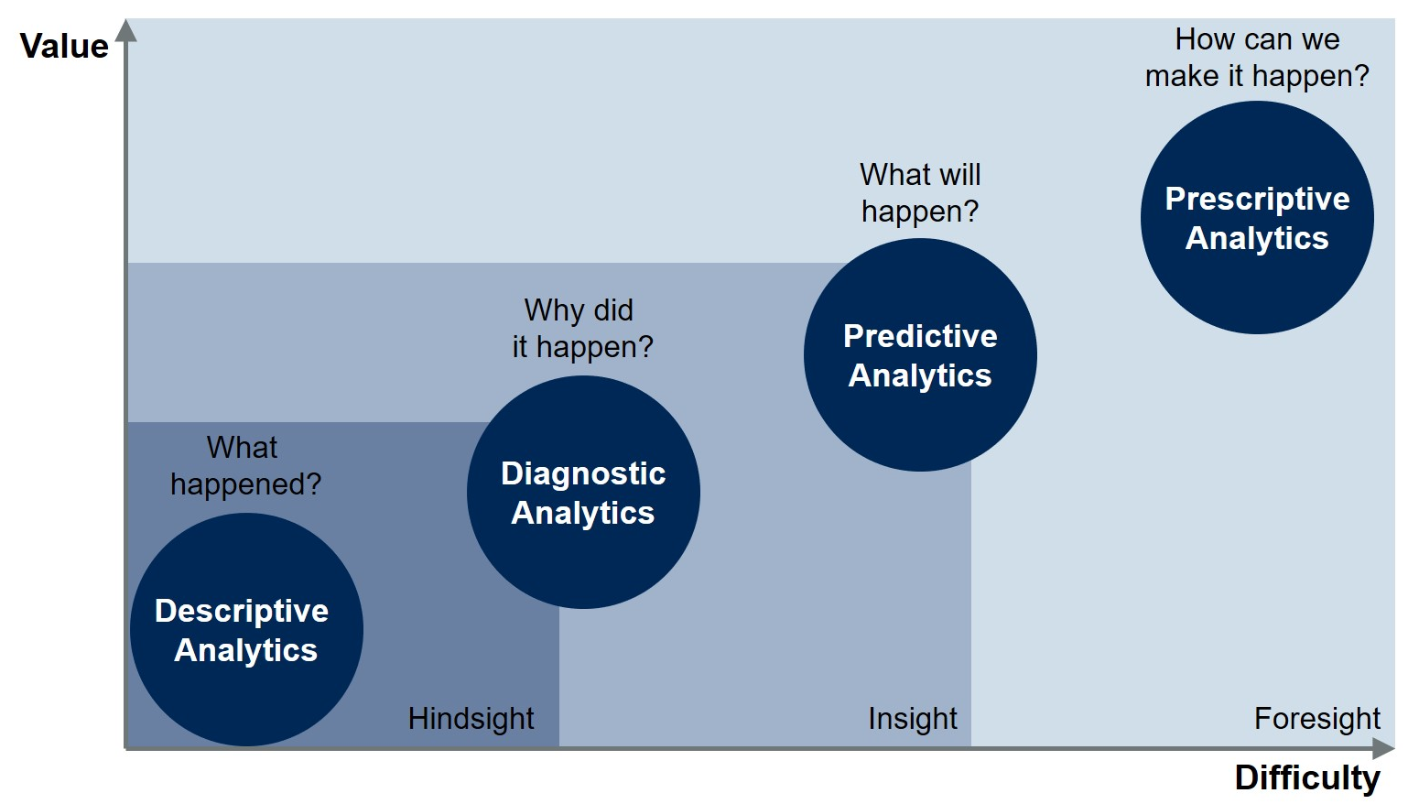
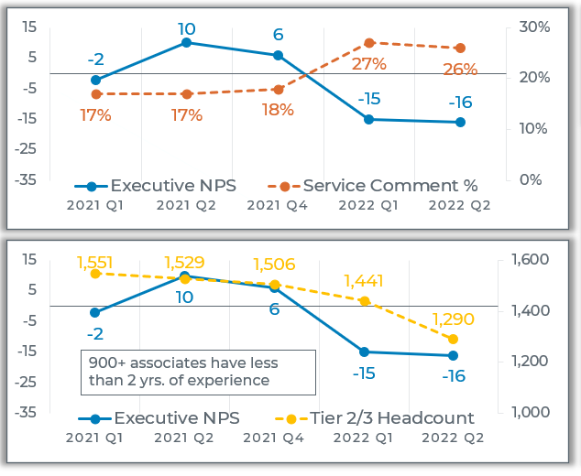
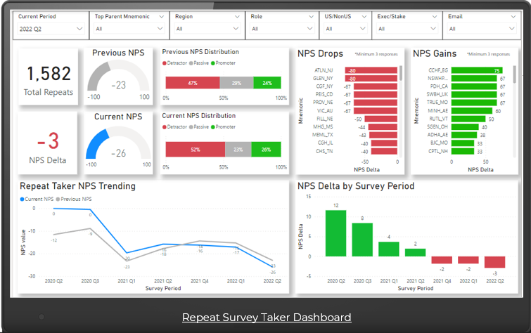
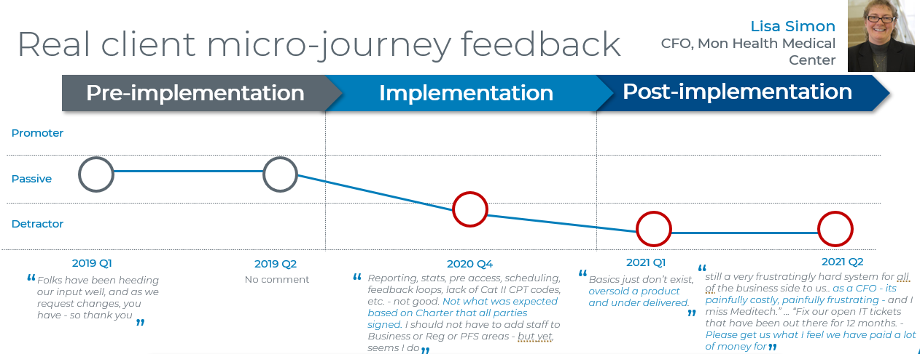
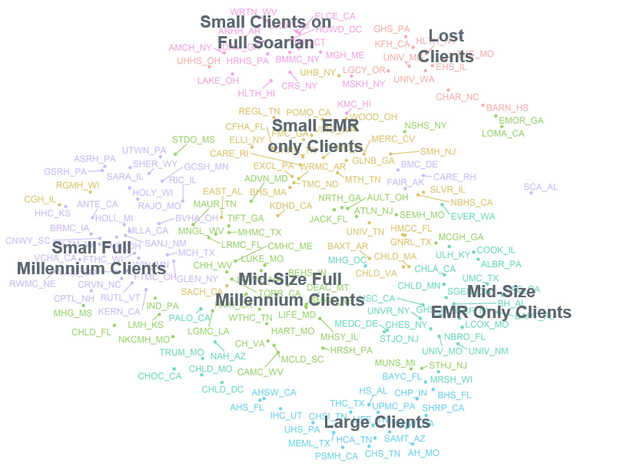
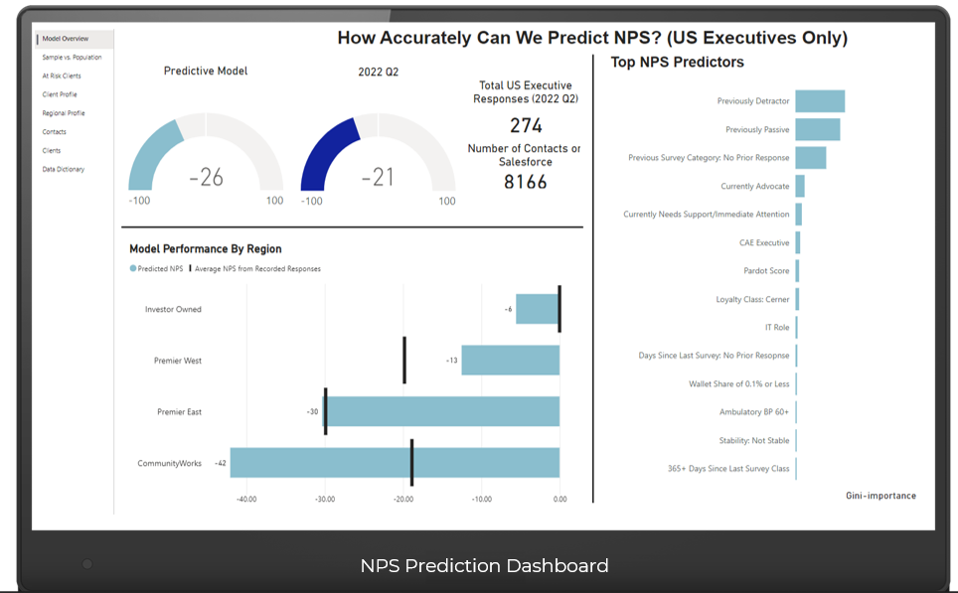
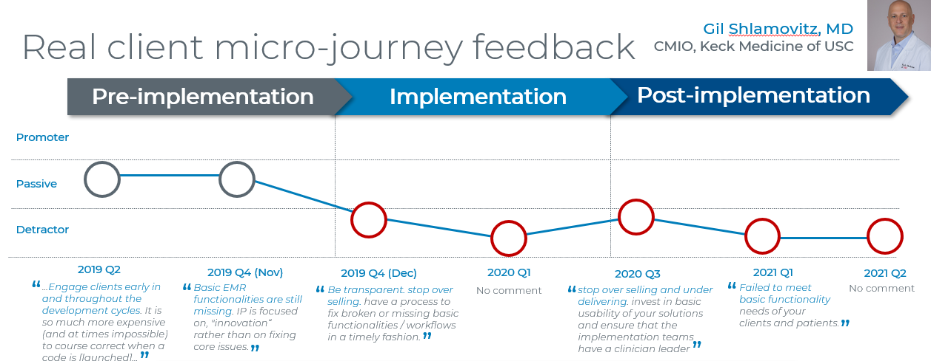
CX Analytics – Long Term Plan
Analytics Maturity Model
Providing first-class analytics, data science and insights capabilities in supporting CX initiatives
Helping to be a CX competitive leader by helping the business make better, faster and relevant data-driven decisions
History of supporting over 30+ business groups with CX analysis needs
Insights
CX Analytics Maturity
CX + OX Analysis
Pre/Post Analysis
Client Journey Maps
Client Cluster/Segmentation
NPS ML Prediction Model

Slide 10
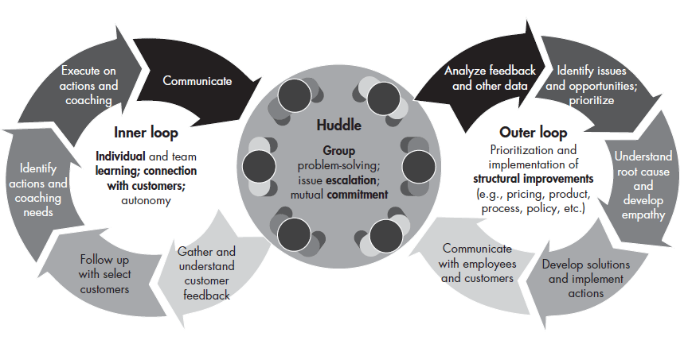
NPS – Bain’s Inner and Outer Loops – Mid to Long Term Plan
Establish Governance Process
The Inner Loop, promotes individual or team learning, while the Outer Loop supports improvements that go beyond individuals or teams

Slide 11
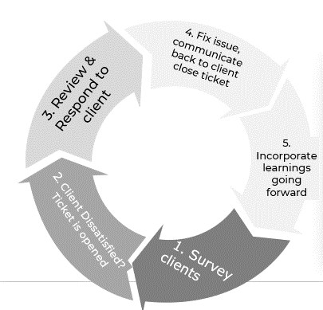
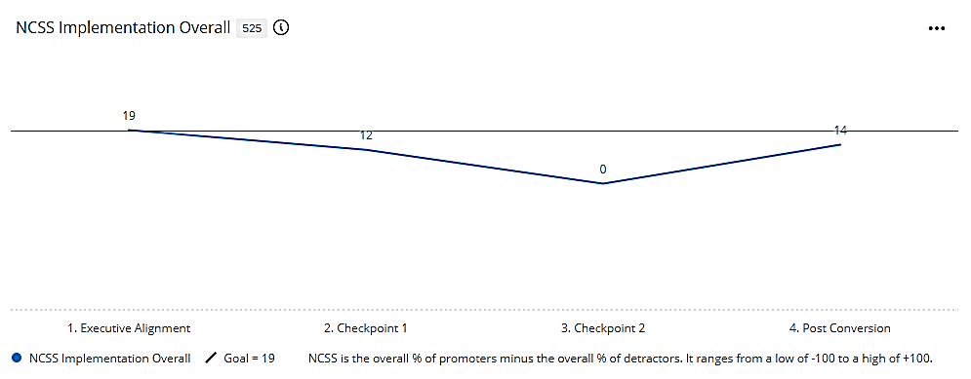
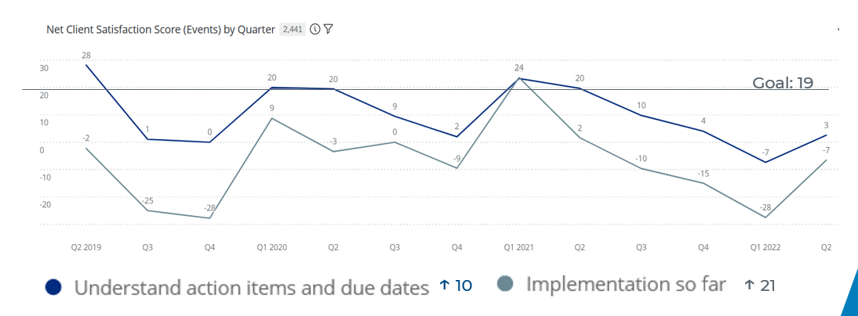
CX Governance and Action Planning
97_84
We’ve deployed Bain and Company’s “Inner and Outer Loop” methodology for improving NPS/Client satisfaction with 8 different business units
Inner Loop
Clients surveyed throughout the implementation journey allowing project teams to react quickly to any dissatisfaction
Leaders identify common pain points and enact plans to mitigate root cause
Notes:
North American consulting and implementation
International consulting and implementation
Veterans’ Administration (VA) consulting and implementation
Continuous Improvement consultants
Strategic Analytics and Adoption consultants
CommunityWorks consulting and implementation
HealtheIntent consulting and implementation
Training and Learning organization

Slide 12
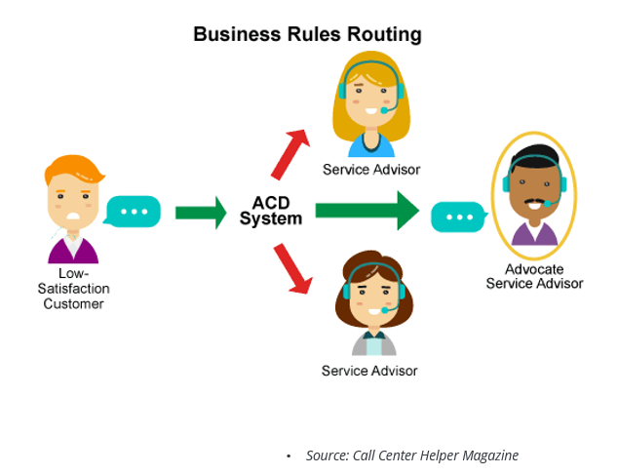
Client Service & Delivery Journey– Client Interaction Model
Implementation
Service
Success
Basic Standard Imp Milestones achieved to transfer to Service
Launch
Discovery
Setup
Test
Go-live
Tier 1
Back to the basics
High Tech touch
Self-Service
Low agent interaction
Tier 2
Advanced or project based requests
1) Med- high touch multi channel
Tech touch – Feedback through surveys – Close loop communication addressing frequent issues
Sales
Gold Standard Imp – High touch with
Additional fee
Med - High Touch –
Surprise and Delight

Slide 13
Delivering Scalable Growth and Operational Excellence
Our objective is to improve service levels and transactional NPS within a scalable model by maximizing additional channels (chat bots, web), intelligent skills-based routing and an operational design to service.
Customer contacts Support using their preferred channel
Customer and their need are identified in the system
Interaction is routed to a queue based on customer’s need
Interaction is assigned based on agents skill 1st and availability 2nd
Email to Case
I have a question about…
Payroll Basic
Web
Chat + Email
Phone
Benefits
payroll
LMS
Payroll Gold
Web to Case
Scheduling
W2’s
GL
Web + Chat
Web + Chat + Email
Web+ Phone
Time Clocks
Wage Garn
Multi-Product Basic
Skill Based Routing
Web
Chat + Email
Web + Phone
+ Email
Taxes
Worker’s Comp
Multi-Product Gold
Chat Bots
Chat + Web
Web + Email
Chat + Phone
New Clients
Email + Web
Chat + Email
Chat + Phone
I am high revenue or at risk…

Slide 14

DANIEL SMITH - Personas
Payroll Contact (25 – 50 EE) | New Contact
I recently started at this company in our Denver branch, one of four locations and am responsible for the payroll of the employees in this location. Because our business is 24/7, different shifts pay different amounts per hour and our vacation time is based on hours worked ever pay period. I constantly get questions from supervisors about the accuracy of their employees pay or vacation but depending on their location, I can’t see their timecards to validate. I know that I am new, but these policies aren’t and I wish I had a better understanding of how our system was set up so I can validate the accuracy myself. I also need to make sure my reporting to our leadership is accurate.
GOALS
Ensure accuracy in payroll for all employees
Ease the frustration of employees and supervisors
Get the right answer about my system
Create easy to use reporting for senior leadership
FRUSTRATIONS
Sending an email and having to wait days for a response
Calling in and getting different answers to my questions, depending on who I talk to
Lack of ownership with problems, especially between our HR and Payroll Specialist
The amount of time it takes to troubleshoot
WANTS
Ability to self service as much as possible
Trust that any representative I talk to will give me the right answer, especially when my person isn’t there
Training on how my system was originally configured
“I want a support team that can help me look like an expert..”
Decision Maker: No
Age: 26 | Location: Denver, CO Industry: Manufacturing
Products: Payroll, HR
Mindset
Preferred Communication Channels
Tech Savvy
Sense of Urgency
Retention Rate
%
Growth Rate
SLA
NPS
Self Sufficient
Driven
Chat
Text
Email
Phone

Slide 15
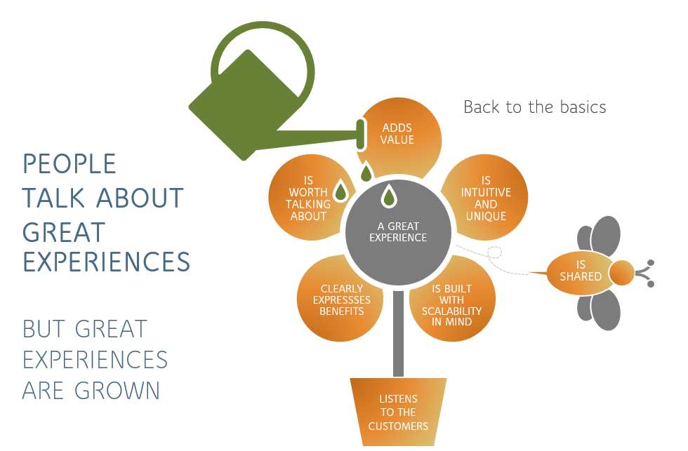
Employee Experience
“Always treat your employees exactly as you want them to treat your best customers.” Stephen Covey

Slide 16
Focus on the
Framework & Roadmap for Employee Experience
Communication the Human Connection
Quarterly Town Halls
Motivational Moments
Company Initiatives Impact on team
Site Updates
Site Newsletter
Criteria for Success
Developing Talent, to Strike the Eye of Posterity
Talent Review
Succession Planning
Career Development Program
Fortifying Leadership
Success
Factors:
Culture of Commitment
Solidify the Team
Clearly Defined Goals and Objectives
Change Management for Transformation
Create and Educate a Clear Vision for the Site
Business growth
Meeting metrics
Highly engaged workforce
Culture of positivity
Unified leadership team
Integrity & authenticity
Gap
Analysis:
No unified vision for the product
Career pathing partnership is lacking
Leading off of assumption vs facts
Engagement Program
Recognition and Celebration
Gratitude Program
Spirit Committee
Professional Development
Lunch and Learns
Measuring for Success
KPI’s
Site Dashboards & Scorecard
Quantitative and Qualitative Measures
Leader
Accountability:
Open communication and feedback
Each leader has ownership to make the team successful
Develop talent across the journey
We set the narrative
Build a Roadmap:
Understand where are we going at all levels
Starting point
Pain Points
Milestones
Finished Objectives

Slide 17
Employee Engagement Initiative Roadmap – Back to the basics
Initiative | As is State | Impacting Objectives | Priority | OKR Impact | Timeline | Owners
Creating Culture of Commitment + & - | Good team chemistry Lack of urgency from the reps to be on the phone Lack clear vision and strategy of the roles? Lack clearly defined goals and objectives? Lots of competing priorities and initiatives People get to know the bare minimum to get by – laid back | Define site brand Create and educate a clear vision for the site Solidify the teams – up and down Clearly defined site goals and objectives Change management for transformation project When you come to me with a problem also provide a solution - mentality
Developing talent, to strike the eye of posterity | Training for success Recruitment is slow – bring me people People want to move after a year- service Lack of engagement in role | Mixture of people who want to master the job and stay and go getters How do we keep people from more than a year? Rewarding people for knowledge Setting role expectations Talent review cTools and process Career development program
Communication- the human connection | We are all on the same team Why are emails so long? So many different tools are used for communication By the time reps get info it’s not clear or detailed | Quarterly site town halls Motivational moments Company initiatives impact on KC Site updates – job openings Site Newsletter Email etiquette training for support
Measures of Success – Employee Retention & Employee Sat

Slide 18
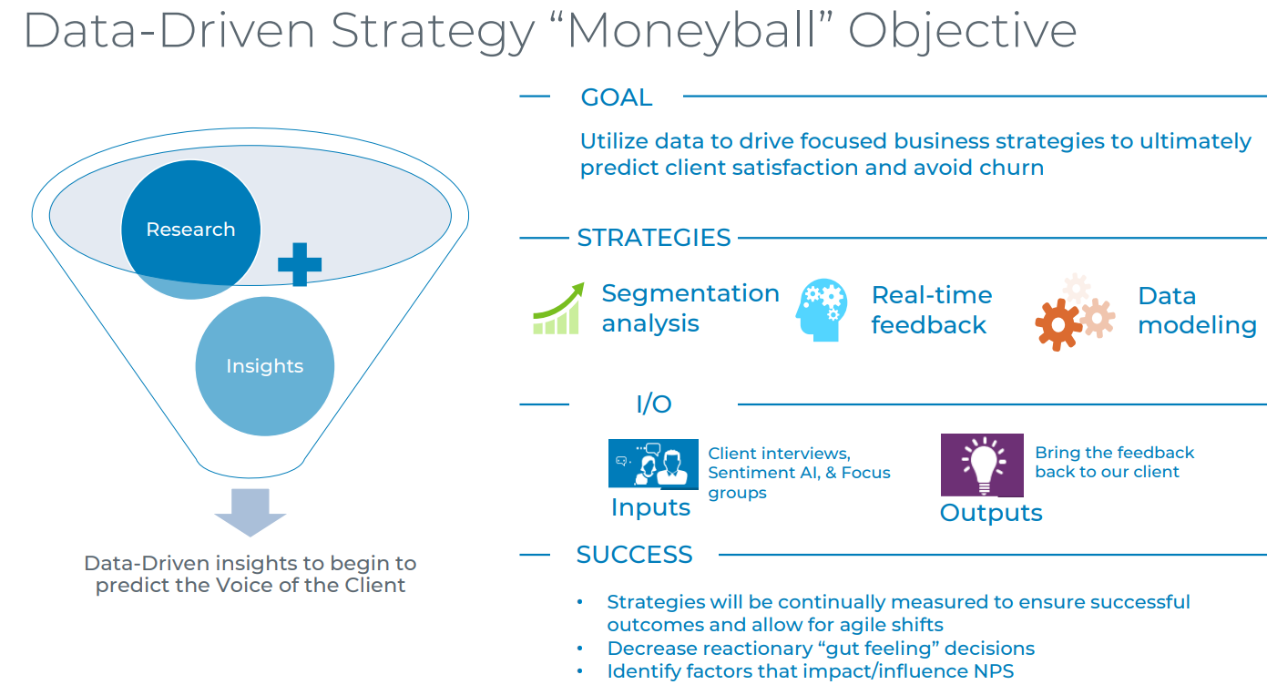
Predictability – Data Driven Insights
“Without data you’re just another person with an opinion.” W. Edwards Deming

Slide 19
Data-driven Retention Program
“Moneyball” VOC strategies
Strategy 1
Segmentation analysis for at-risk clients
Leverages cluster analysis to create client segmentation; aligned characteristics utilized to determine specific and meaningful retention approaches
Strategy 2
Real-time product feedback through AI
Leverage tools (i.e. Pendo) to survey along the product journey, close whitespace gaps through projects, and close the inner-loop
Strategy 3
Machine learning
model creation
Create predictive models around client NPS scores to pinpoint factors that make successful and unsuccessful clients
Inputs
Client interviews and focus groups
Targets clients with both positive and negative NPS scores to develop action planning aligned with client pain points and best practices
Outputs
Bring the feedback to our clients
Create a holistic view of the client experience and share valuable action with stakeholders through roadshows and partnering to fix client pain points as identified in data gathering
Notes:
I want to take a moment to introduce the Voice of the Client Moneyball strategy to support our data-driven retention proposal. This is a 5-step strategy we are working through that we believe will really move the meter and help us identify risks. You can see #2, which is the segmentation analysis for at-risk clients, that we just talked through in the last few slides about leveraging the cluster analysis to increase our understanding of our client base by identifying key similarities and determining meaningful retention approaches. Our goal is to shift from processing survey data, which is often lagging indicators of client satisfaction, and instead leverage our data and analytics teams to drive real-time predictive analytics through various advanced techniques. This will allow us to make predictions about future outcomes using historical data combined with statistical modeling, data mining techniques and machine learning, which will allow us to quickly identify and remediate risks and maximize on opportunities based on our client interactions.

Slide 20
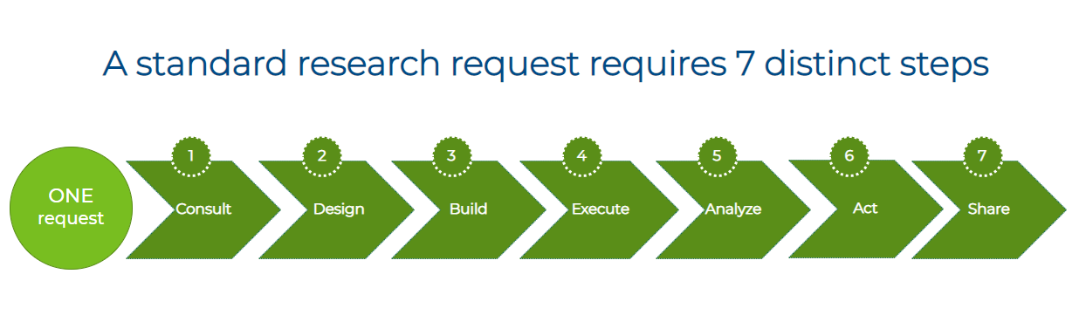
“Project Illumination” Client Facing Research
“Supposing is good but finding out through research is better.” Mark Twain

Slide 21
Project Illumination – CX Project Plan
Deliverables | Target date | CX Owner
CX Robust project plan created | 8/15/2022
Client journey mapping – pain points and delighters – Current state | 9/30/2022
Create process to collect & leverage feedback from clients along the impacted journey: Contracting – whitespace Identify gaps - whitespace | 10/15/2022
Value outcomes identified – how do we structure our questions | 9/30/2022
Create process to collect & leverage feedback from clients along the impacted journey. - Current research inventoried: Existing research we can use to baseline Adjustments to existing surveys | 10/15/2022
Create new research listening posts – As needed | Ongoing
Impacted operational groups identified – Who do we work with/key stakeholders? | 9/15/2022
Buildout of Qualtrics – Survey’s, dashboards etc. | 11/30/2022
Process documentation Document the repeatable steps CX Insights & Research will go through for this project Deliver the right info to the right people at the right time so they can take action Assign ongoing touchpoint intervals Establish governance process of the data | 11/30/2022
Create new reporting and insights based on data gathered | 1/30/2023
Communication planning TBD | Ongoing

Slide 22
“Project Illumination” Program Offering – World class VOC process
Scope of work:
Initial consult – On-site visit and info gathering
Client end-user surveys design or client facing interviews moderator guide
Build, launch , reminders & close survey or facilitate interviews
Timeframe:
4 weeks for survey design
3-4 weeks for research to be conducted
Deliverables:
Survey design / moderate guide
Survey preview
Interviews
Insight
Scope of work:
Monitor feedback
Initial results
Key driver analysis
Data splits
Development of insight presentation
Timeframe:
2 days for initial results
3-4 weeks for development of insights presentation
Deliverables:
Presentation of insights
Raw data files
Listen
Scope of work:
Communicating back to the client progress on actions
Communication to Cerner associates on project outcomes
Work with client to communicate to end-user the actions taken based on feedback
Send out a CSIP survey to measure success
Timeframe:
60-90 days post survey close
30 days post improvement work
Deliverables:
Email to clients/ end-users
Scope of work:
Document key actions from presentation of insights
Create improvement plans utilizing the Arch playbook (CSIP)
Monitor and manage actions
Work with BGs to address Cerner actions
Align clients with Peers to collaborate on best practice
Timeframe:
2 days prep time for meetings
4-8 months for improvement work
Deliverables:
Monthly meeting to discuss actions/follow-ups – client level inner loops based on ongoing feedback if applicable
Close Loop
Action

Slide 23
Guide | Client Facing Research
Overview
Advantages
How to sell
Additional Resources
Business Strategy
Bring caregiver research in-house to prevent risk of 3rd party research biasing results. We will use the research to bring awareness, understand positive and negative gaps in a users product experience and partner with clients to mitigate issues to reduce churn.
End user data can be used within our data warehouse to drive predictive analytics and bring visibility to client facing teams.
Market solution
Employee burnout and attrition is at an all time high. Clients need insights into areas to help improve their experience.
Client research is designed to help:
Bring visibility to perception and satisfaction with the products/services
Pinpoint insight to improve experience
Partner on addressing any areas of dissatisfaction
Summary
Client Experience Research – a comprehensive service that spotlights your user experience with your products using proven market research. Work is done in partnership with you to help understand any experience gaps and how to moderate them.
Client Experience Research has 50+ years of experience in client experience and has supported over 10 unique companies with their research needs. We work closely with the client to understand their needs, their environment and key impacts to overall satisfaction with the products.
Value proposition
Helping organizations use insights to make their environment more effective and efficient

Slide 24
Guide | Client Facing Research
Overview
Advantages
How to sell
Additional Resources
Product offerings
Voice of client research
Initial consult: on site visit / virtual meeting to understand organizations needs, educate on program and discuss process.
Survey execution: surveys design, build, launch, reminders, monitor feedback & close survey
Insights: conduct key driver analysis, data splits & development of insight presentation to key client stakeholders
Actions: document key insights & get alignment on ownership to create action plans based on the key areas defined
Insight deep-dive
Operational Network Analysis: utilized usage and adoption metrices from ancillary systems and data points to help pinpoint root cause
Day in the Life: Facilitate workshop to review comments and narrow in on key themes to understand the experience and better align actions.
Peer collaboration
Reference visit: Clients can share their own unique stories with the prospective/ target clients. This dialogue can be anything from a telephone conversation, a web conference, or an on-site meeting with one or more organizations to discuss experiences with solution design/workflow, lessons learned, best practices/success, value/benefits realized, feedback on improvement programs, and/or future vison.
Measurement strategy
PDCA: Follow the Plan, Do, Check, Act (PDCA six sigma) methodology to track success of action plans
Remeasure: Reach out to end users via follow-up survey and/or facilitate interviews to understand further details
Notes:
(use Qualtrics action planning platform?)
Text analytics??

Slide 25
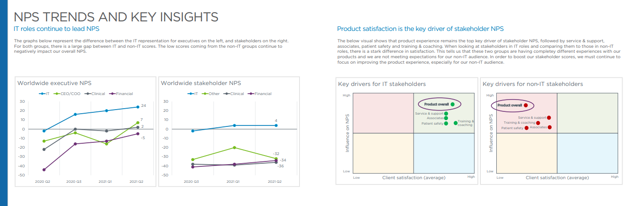
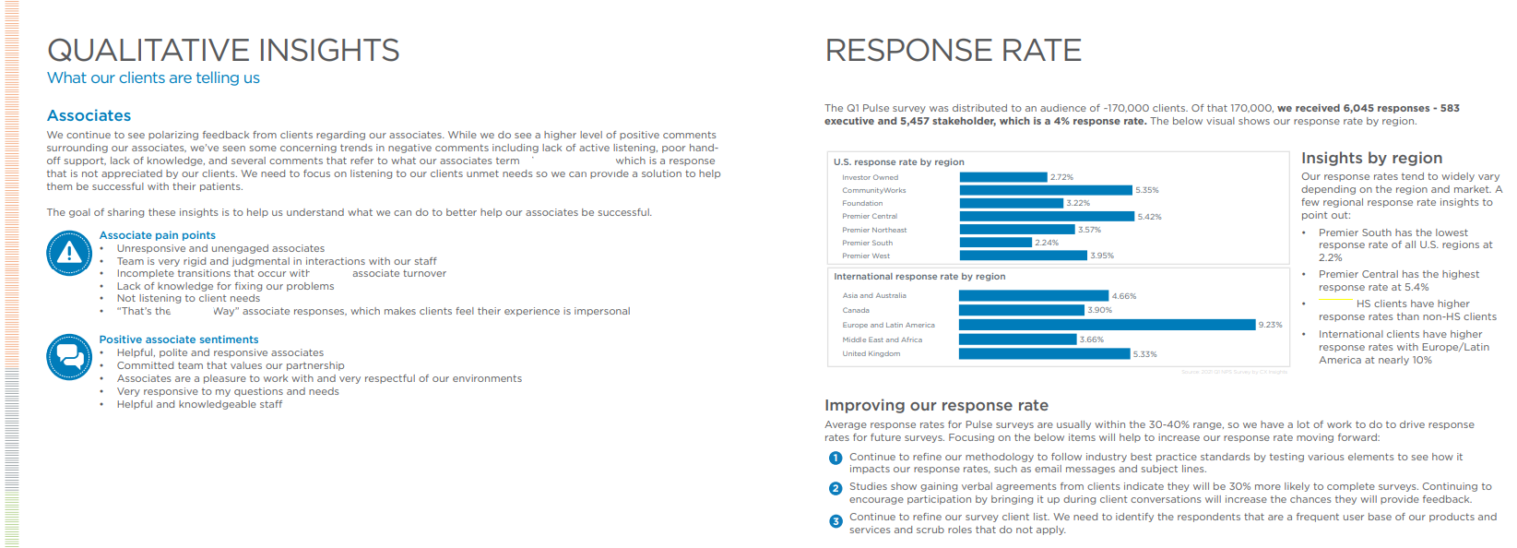
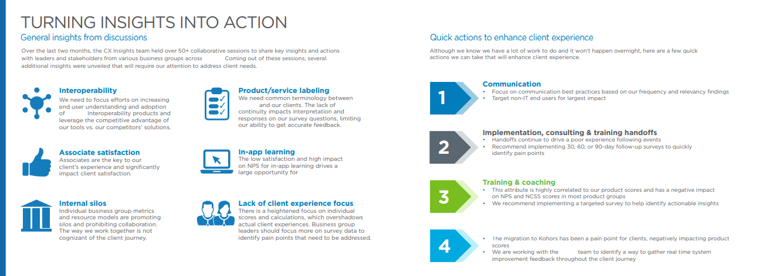
Sample Output: Research Reporting & Overview
Sample Media Output Based on Audience or Leadership Preference:
Format | Frequency | Purpose | Audience
PP State of the Union Presentation/Address | Quarterly | Share quarterly feedback results with key leaders of the business | C-Suite VP and above
PDF Comprehensive Report | Quarterly | Share quarterly feedback as a report for external analysts and internal consumption of the business | All Company External parties such as Gartner
Office Hours | Monthly | Work with key partners across the organization on research efforts/needs and review of data for inner loop action planning sessions | Program Managers Business Unit Leaders
Team Meetings & Action Planning Sessions | Monthly | Work on sharing insights gathered for the month along the client journey. Create action plans with owners and deliverables based on pain points | Program Managers Business Unit Leaders
Closed Loop- Client Facing Output | Quarterly | Share feedback with clients to ensure they know they are being heard | Client Managers Clients
Sample Report

Slide 26
Change management – plan on a page
Purpose: Help employees transition to Canva as the primary self-service creative platform by building awareness, desire, knowledge, ability and reinforcement. The change supports faster asset creation, easier access to approved templates, improved brand consistency and reduced dependency on routine creative production support.
A
Awareness
D
Desire
K
Knowledge
A
Ability
R
Reinforcement
Employees understand why we are moving to Canva.
Employees see personal value and want to participate.
Employees know how to use Canva and get help.
Employees can use Canva successfully in daily work.
Canva becomes the standard self-service way of working.
• Communicate vision and rationale • Share timeline, milestones and FAQs • Launch “Coming Soon” message
• Show faster, easier, on-brand self- service • Share demos and early examples • Address resistance and questions
• Deliver live and on-demand training • Create quick-start guides and FAQs • Clarify access, templates and governance
• Launch workspace and approved templates • Host office hours and support channel • Track and fix issues quickly
• Measure usage, downloads and feedback • Recognize champions and share wins • Run lessons learned and refresh guidance
Success:
Employees know what is changing, why it matters and when.
Success:
Employees support the change and feel motivated to try Canva.
Success:
Employees know how to access Canva, use templates and get support.
Success:
Employees actively create assets using approved Canva templates.
Success:
Adoption is sustained through governance, metrics and feedback.
Key deliverables
Success measures
• Change management plan • Communications plan • Stakeholder engagement plan • Training and support plan • Sponsorship plan • Adoption dashboard • Lessons learned review
• Active Canva users • Template adoption and downloads • Reduction in creative requests • Training engagement and support trends • Employee satisfaction and feedback • Improved brand consistency through approved templates
Notes:
[Sources] - Canva project overview.pptx: Used for the project purpose, including establishing Canva as the primary self-service creative platform, improving brand consistency, reducing dependency on routine creative production support, and proposed adoption KPIs. - Prosci-ADKAR-Outcomes-and-Milestones-Canvas.pdf: Used for ADKAR stage structure and outcome framing: Awareness, Desire, Knowledge, Ability, Reinforcement. - Change management template.pptx: Used for change management deliverables and planning categories, including communications, training, stakeholder engagement, sponsorship, risk/resistance, measurement and reinforcement. [/Sources]

Slide 27
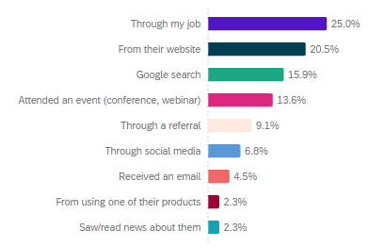
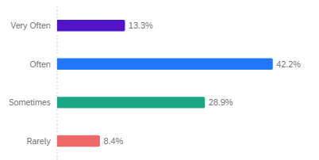
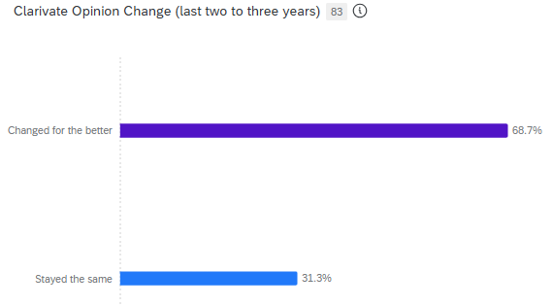
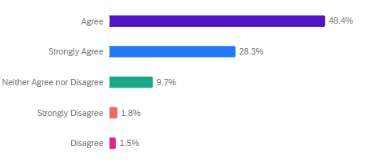
Market research dashboard
Brand performance
Brand strength
Brand awareness
Aided awareness vs competitors
Equity score
3.4%
NPS
32
Aided
awareness
16.1%
TBD
+5.6% YoY
+0.9% YoY
-30 YoY
+1.4% vs. market avg
+13.4% vs. market avg
+2.2 vs. market avg
All brands have seen an increase in awareness with XXX experiencing the highest gains +5.6% YoY vs these competitors
Top of
mind
Brand exposure
2.7%
Flat
YoY
Familiar first
How often have you heard about XXX brand in past 6 months?
Unaided
awareness
5.0%
Flat
YoY
Very often +6%
Evidence of strong Masterbrand health and recognition through continued equity increases
Key opportunities for increasing sub-brand equity by leveraging the Masterbrand brand name and imaging
Statically significant ​shift upward in familiar first metrics around our website and google channels
Statistically significant shift upward in our positive Think forward metrics
Brand perceptions
How has your opinion changed of XXX brand in the past 2-3 years??
XXX
demonstrates
Think forward promise
Change for the better
+6.8% YoY
76.7%
+6.8% YoY
Notes:
Equity – Continued growth in our brand equity score signifies validity in our brand strategy – to sustain growth we must provide consistency around our brand promise and improve our customer experience through continues collection and adoption of data driven feedback. Provide ongoing, relevant communication that fuels brand affinity. Reinforce differentiation that sharpens our value proposition. Track competitor campaigns, innovation, and sentiment. Continue to monitor our positioning through research measurement and reinforcement of insights.
NPS – there is a statistically significant drop in NPS score for each sample in both the score and the overall market NPS scores. A market drop in NPS scores signifies the following market expectation shifts: The potential “why’s”
1. Market Disruption or Change​ - New regulations, pricing models, or technology shifts can create confusion or dissatisfaction.​
Example: A change in privacy laws or subscription models that affects all providers.​
2. Customer Expectations Have Shifted​- Customers may now expect faster service, better personalization, or more transparency.​
If no competitor is meeting these new expectations, NPS scores will drop across the board.​
3. Economic or Social Factors​- Economic downturns, inflation, or social unrest can make customers more critical or less loyal.​
Even if service quality remains the same, perceived value may decline.​
4. Negative Media or Public Sentiment​- A scandal, data breach, or poor press involving one major player can spill over to others in the same space.​
Customers may lose trust in the entire industry.​
5. Increased Competition from Outside the Market​- A new entrant (e.g., a tech company or startup) may offer a radically better experience, raising the bar.​
Customers compare legacy providers unfavorably, even if they haven’t switched yet.​
6. Service Saturation or Fatigue​- If the market is oversaturated, customers may feel overwhelmed or fatigued by similar offerings.​
This can lead to indifference or frustration, lowering NPS.​
Brand exposure – HUGE shout out to our web 2.0 project. We see a statistically significant shift in our first familiar metrics in each sample with our website growing as one of the key channels for how our customers and prospects are hearing about the brand. We also see growth in our social media awareness.
Huge shout out to our external comms team - Our metrics around how often people have heard about in the past 6 months has seen a shift into the “very often” category from our “often” category +6%.
Brand perceptions – We see positive movement in the opinion change of our marketplace over the last two samples. 6.8% YoY. There have been no respondents that have given a negative response to this question in the past 3 samples, indicating high brand perception in the brand.
Our think forward promise shows statistically significant movement upward as we continue efforts to educate our marketplace on the values this messaging presents
Brand awareness – We see a large movement upward of our aided awareness metrics. This coupled with our strong equity growth shows our reach is expanding and our reputation is strengthening. Strong increase in brand awareness shows brand salience, new audience exposure, and effective marketing and communication efforts.
In the past 3 samples we see the following increase in our competitors' numbers around the aided awareness metrics:
S&P Global – 2.9%
Thomson Reuters – 0.6%
- 5.6%
Wolters Kluwer – 1.1%
Relx – 0.6%

Slide 28
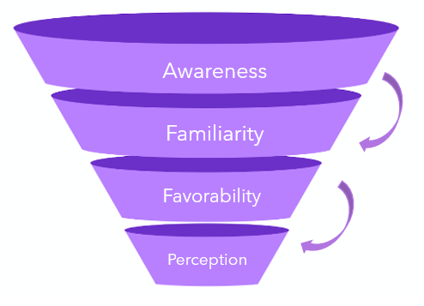
Brand familiarity and health measurement
Description: Providing research and insight methodology to investigate the value and saturation of various aspects of our brand. This process fosters and strengthens brand awareness that can help curate brand value with prospects and existing clients.
Brand/competitor Research
Qualtrics brand research | Manager project and guide teams through key steps Share data, insights and trending information
Internal brand research | Customer interviews and focus groups – where needed Build process to share all forms of brand research in one location Conduct on-line polling based on defined needs (digital experience)
Website demand generation | Support Marketing to drive demand Assess and execute initiatives to increase conversion optimization A/B Testing & and optimization for digital changes AA compliance status – process creation and implementation
Internal brand pulse | Administration and support for internal brand pulse measurement and insights
Brand journey feedback dashboard/reporting | Create strategy for comprehensive reporting/dashboards that disseminate feedback throughout the customer journey around brand (ITS)
Competitor research | Value proposition benchmarking (VARS model) Spot emerging trends or features competitors are adopting H1 corporate narrative and H2 Otterly review of overall brand perception & 1 other topic TBD
Integrated Brand Experience
Experience insights
Equity
Awareness
Associations
Perceptions
Loyalty
Advocacy

